Slide 1
Men’s Health
The Nutritional Dimension

Slide 2
Disclaimer
Slides shown are only for educational purpose.
Products or ingredients discussed herein are not intended to diagnose, treat, cure or prevent any disease.

Slide 3
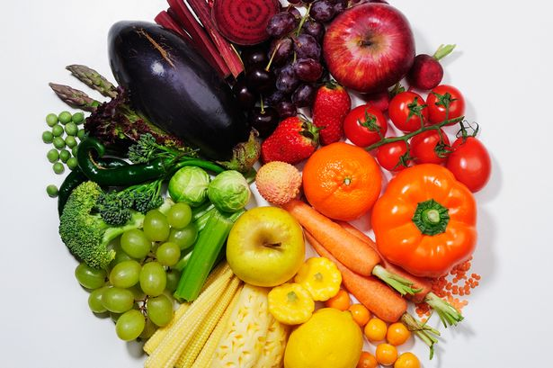
Working Towards A Healthy Lifestyle?
Healthy diet
Frequent exercise
Ample sleep
Little stress

Slide 4
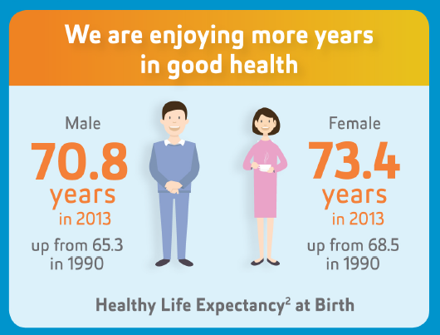
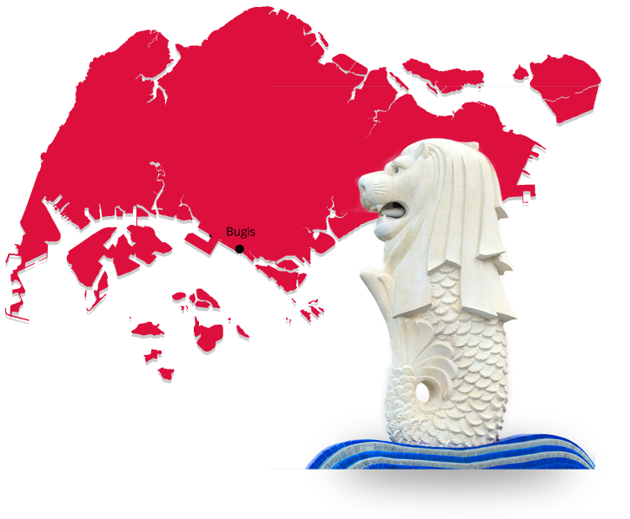
Male Healthy Life Expectancy
Average healthy life expectancy for man in Singapore is 70.8 years.
(compared with 73.4 years for women)
Singapore Ministry of Health

Slide 5
The Prostate Function Plays A Critical Role In Men’s Health

Slide 6
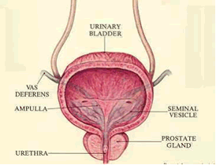
Prostate
Walnut sized gland that sits just below the bladder and surrounds the urethra (carries urine through penis)
Functions
Store and secrete a mild alkaline milky white liquid
This constitutes ~30% of seminal fluid volume
Alkalinity helps reduce acidity of vaginal tract to prolong sperm lifespan
Prostate Cancer Treatment Research Foundation

Slide 7
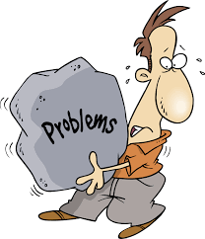
Prostate Problems
Enlarged prostate
Prostate infection
Prostate cancer

Slide 8
Prostate Concern (Signs and Symptoms)
Frequent urge to urinate
Urgency to urinate
A weak or slow urinary stream
A urinary stream that starts and stops
Difficulty in urinating
Painful or burning urination
Inability to urinate
Dribbling of urine
Blood in urine or semen
A feeling of incomplete bladder emptying
Getting up frequently at night to urinate
Erectile dysfunction
Painful ejaculation
Frequent pain or stiffness in lower back, hips, or upper thighs
Discomfort in the pelvic area
Bone pain
If you or someone you know has any of these symptoms,
a doctor should be consulted as soon as possible.
Prostate Cancer Treatment Research Foundation

Slide 9
Prostate Health Awareness
Prostate Cancer is the 3rd most common cancer amongst Singaporean men.
On an annual basis globally, approximately 1.1 Million Men are diagnosed with prostate cancer.
Prostate cancer usually occurs after the age of 50 years and is seen mostly in those over 70 years of age.
Singapore Cancer Registry, Interim Annual Registry Report Trends in Cancer Incidence in Singapore 2010 – 2014
Prostate Cancer Treatment Research Foundation
National Cancer Centre Singapore, SingHealth

Slide 10
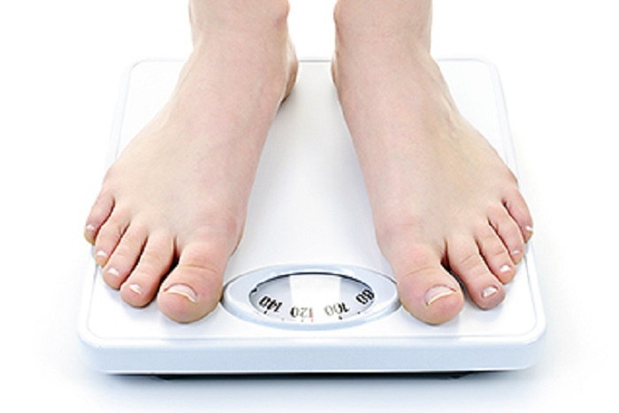
What You Can Do to Maintain a Healthy Prostate
Diets
High in vegetables and fruits
Researchers believe that antioxidants including vitamin C and carotenoids are beneficial
Reduce stress
Regular exercise
Maintain normal bodyweight
No smoking
Regular medical checkups
Harvard Health Publication
John Hopkins Medicine

Slide 11
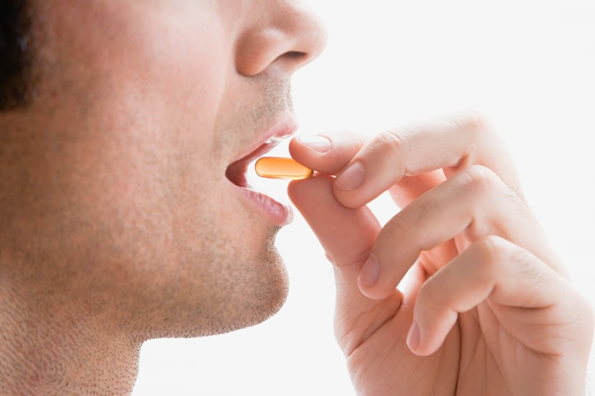
Can supplements help?
Vitamins, minerals and herbals can help.
They are important for keeping the prostate healthy.
May help in relief of symptoms.
Some have been shown to be beneficial in inhibiting excess growth or enlargement.
They are not a cure; they are a preventative.
They should not be used as a substitute for the care of a doctor.

Slide 12
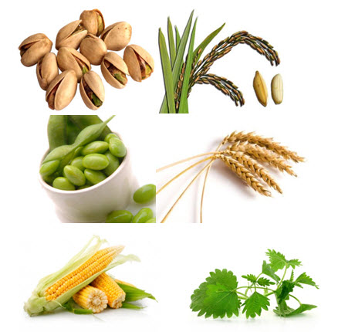
Plant Sterol (Beta sitosterol)
Nutritional Support for Prostate Health
Plant sterol with chemical structure similar to cholesterol.
May help in the treatment of symptoms of benign prostate hyperplasia (BPH).
Research shows improvements in urinary symptoms, maximum urinary flow and decrease in post void residual urine volume.
May inhibit 5-alpha-reductase enzyme activity.
University of Michigan Health System – Beta Sitosterol Plant Extract

Slide 13
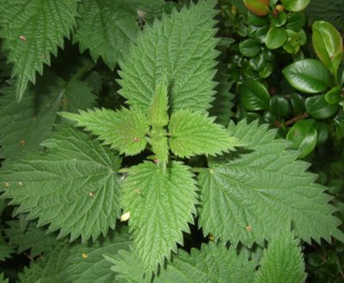
Nutritional Support for Prostate Health
Stinging Nettle
Studies show that it may help in slowing or reducing excessive prostate tissue growth by inhibiting the effects of hormones such as dihydrotestosterone (DHT).
University of Maryland Medical Center – Stinging nettle

Slide 14
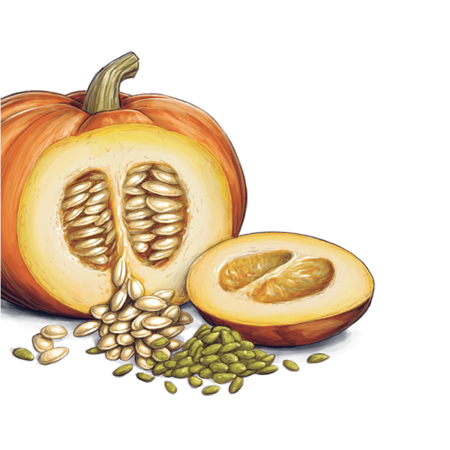
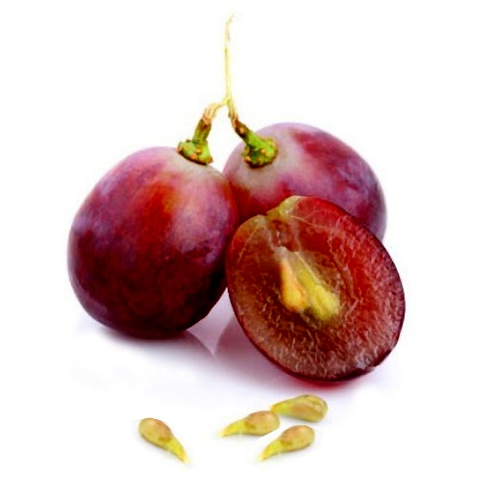
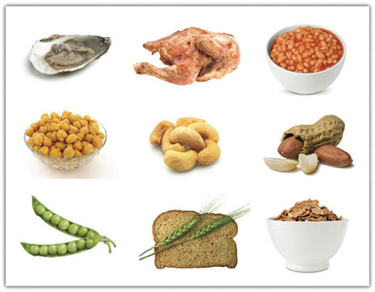
Nutritional Support for Prostate Health
Pumpkin Seeds
May help with symptoms as it
exhibits a diuretic affect.
Promotes urinary flow and
thereby may reduce bladder
discomfort.
Grape Seed
Great antioxidant and free radical scavenger.
Helps maintain normal circulation.
Zinc
Helps to maintain prostate health.
Within the body, zinc accumulates higher in prostate than in any other soft tissue and those with prostate concerns often test low for zinc.
Abdel-Rahman, M. World Journal of Chemistry. 1(1): 33-40, 2006.
Agarwal, C., et al. Carcinogenesis. 28(7): 1478-1484, 2007.
Costello, L. and Franklin, R. Prostate. 35(4): 285-296, 1998.

Slide 15
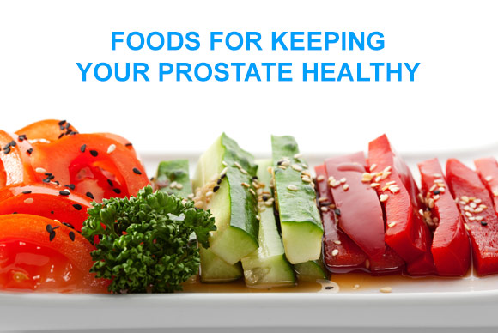
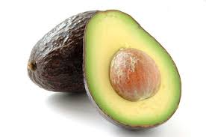
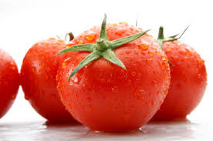
Other Beneficial Nutrients for Prostate Health
Walnuts
Broccoli
Green Tea
Kidney Bean
Pomegranate
Selenium
Soy
Vitamin D
Lycopene
Salmon
Pumpkin Seeds
Avocado
NIH National Cancer Institute

Slide 16
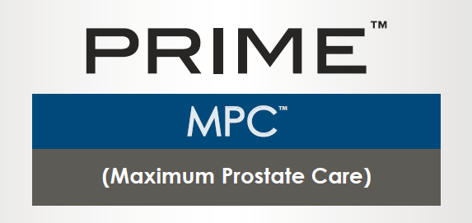
INTRODUCING
Protect The Guys Who Matters Most

Slide 17
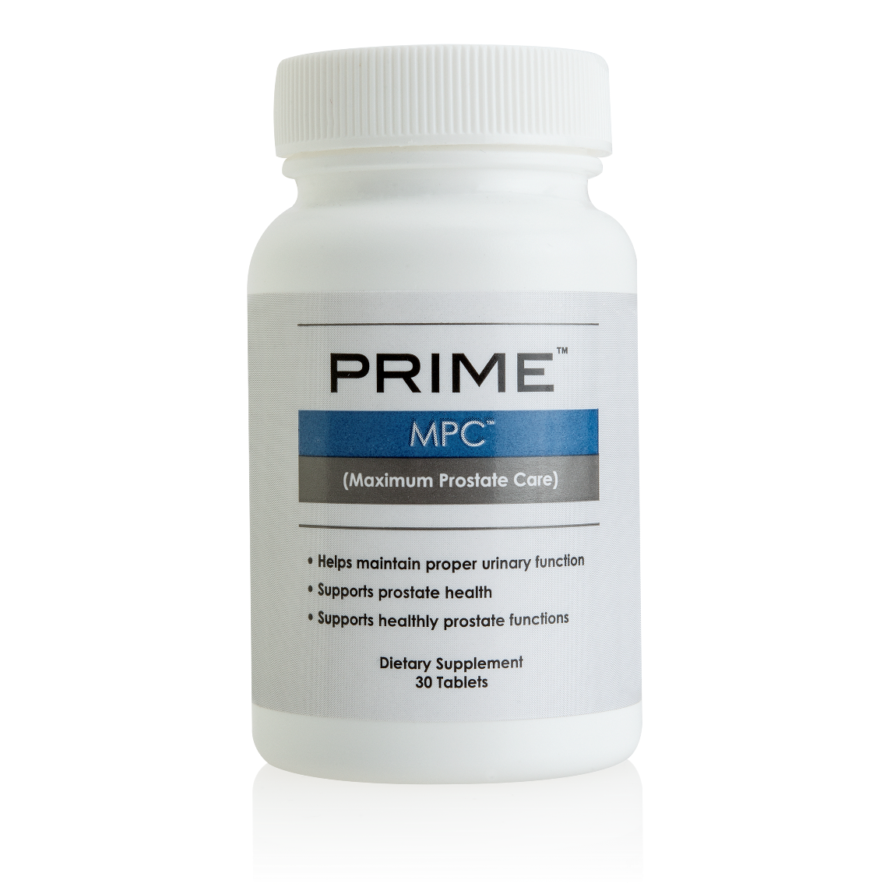
PRIME MPC™
What can Prime MPC™ do for you?
Helps maintain proper urinary function
Supports prostate health
Supports healthy prostate functions
Available
Now!
MASG – Code: SG13158 | UC : S$54.50 | SR : S$76.50 | BV : 27

Slide 18
What makes Prime MPC™ unique?
Available
Now!
Combines herbal ingredients and selected nutrients that work synergistically to benefit men’s prostate health
Provides antioxidant protection
MASG – Code: SG13158 | UC : S$54.50 | SR : S$76.50 | BV : 27
† GeniVida™ is a trademark of DSM Nutritional Products.

Slide 19
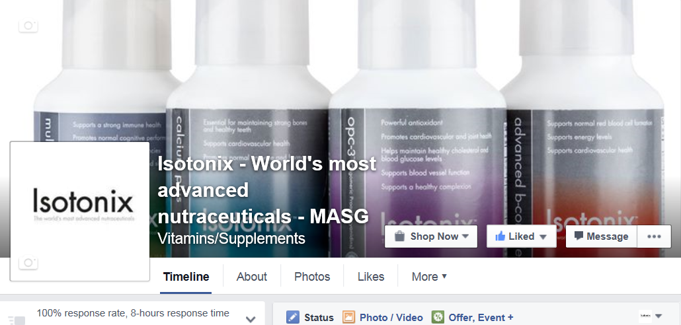
SOCIALISE WITH US :
Like our Market Singapore Isotonix facebook page. facebook.com/isotonixmasg
®

Slide 20
Men’s Health
The Nutritional Dimension

